Slide 1
Chapter 9
Software Maintenance

Slide 2
Chapter 9
Software Maintenance
9.1 Software Evolution
9.2 Types of Software Maintenance
9.3 Maintenance Techniques
9.4 The Management of Maintenance
9.5 Qualities in Maintenance
9.6 Reengineering, Reverse Engineering and Forward Engineering
Exercise

Slide 3
9.1 Software Evolution

Slide 4
Software Evolution
It is impossible to produce system of any size which do not need to be changed. Once software is put into use, new requirements emerge and existing requirements changes as the business running that software changes.
Parts of the software may have to be modified to correct errors that are found in operation, improve its performance or other non-functional characteristics.
All of this means that, after delivery, software systems always evolve in response to demand for change.

Slide 5
Program Evolution Dynamic
Program evolution dynamic is the study of system change. The majority of work in this area has been carried out by Lehman and Belady. From these studies , they proposed a sets of laws concerning system change.
Law | Description
Continuing change | A program that is used in real-world environment necessarily must change or become progressively less useful in that environment.
Increasing complexity | As an evolving program changes, its structure tends to become more complex. Extra resources must be devoted to preserving and simplify the structure.

Slide 6
Program Evolution Dynamic (cont’d)
Law | Description
Large program evolution | Program evolution is self-regulation process. System attributes such as size, time between release and the number of report errors are approximately invariant for each system release
Organizational stability | Over a program’s lifetime, its rate of development is approximately constant and independent of the resources devoted to the system development
Conservation of familiarity | Over the lifetime of system, the incremental change in each release is approximately constant.

Slide 7
Software Evolution Approaches
There are a number of different strategies for software change.[SOM2004]
  Software maintenance
  Architectural transformation
  Software re-engineering.
Software maintenance
  Changes to the software are made in response to changed requirements but the fundamental structure of the software remains stable. This is most common approach used to system change.

Slide 8
Software Evolution Approaches (cont’d)
Architectural transformation
  This is a more radical approach to software change then maintenance as it involves making significant change to the architecture of the system.
Software re-engineering
  This is different from other strategies in that no new functionality is added to the system.
  System re-engineering may involve some structural modifications but dose not usually involves major architectural change.

Slide 9
9.2 Types of Software Maintenance

Slide 10
Software Maintenance
Software maintenance is the general process of changing a system after it has been diverted.
The change may be simple changes to correct coding errors, more extensive changes to correct design errors or significant enhancement to correct specification error or accommodate new requirements.

Slide 11
Maintenance Characteristics
We need to look at maintenance from three different viewpoints: [PRE2004]
  the activities required to accomplish the maintenance phase and the impact of a software engineering approach (or lack thereof) on the usefulness of such activities
  the costs associated with the maintenance phase
  the problems that are frequently encountered when software maintenance is undertaken

Slide 12
Types of Maintenance
Maintenance to repair software faults
  Changing a system to correct deficiencies in the way meets
  its requirements
Maintenance to adapt software to a different operating environment
  Changing a system so that it operates in a different environment (computer, OS, etc.) from its initial implementation
Maintenance to add to or modify the system’s functionality
  Modifying the system to satisfy new requirements

Slide 13
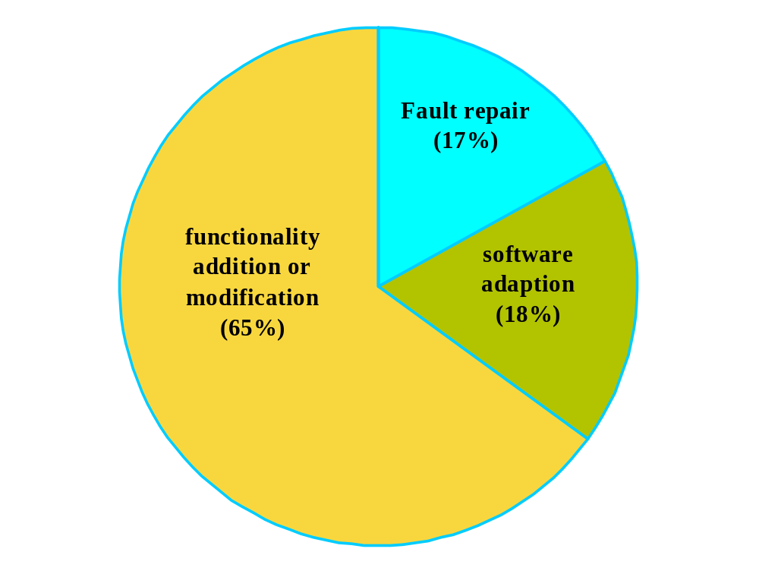
Maintenance effort distribution .[SOM2004]

Slide 14
Development vs. Maintenance
not directly linked to the real world | directly driven by the real world
freedom | constrained by existing system
defects have no immediate effect | defects disrupt production
methods available | system not using current methods
standards may be enforced | shifting standards, if any

Slide 15
Maintenance Examples
Y2K
  many, many systems had to be updated
  language analyzers (find where changes need to be made)
Anti-Virus Software
  don't usually have to update software, but must send virus definitions

Slide 16
Maintenance Examples (cont’d)
Operating System Patching
  Microsoft, Apple, Linux/Unix
  OS is core to use of computer, so it must be constantly maintained
Commercial Software in General
  customers need to be informed of updates
  updates have to be easily available - web is good tool

Slide 17
The Maintenance Process
Maintenance process vary considerably depending on the types of software being maintained, the development processes used in an organization and people involved in the process.
Change requests
Impact analysis
Release planning
Change implementation
System release
Fault repair
Flat form adaptation
System enhancement
Overview of the Maintenance Process .[SOM2004]

Slide 18
Change Requests
Change requests are requests for system changes from users, customers or management
In principle, all change requests should be carefully analysed as part of the maintenance process and then implemented
In practice, some change requests must be implemented urgently
  Fault repair
  Changes to the system’s environment
  Urgently required business changes

Slide 19
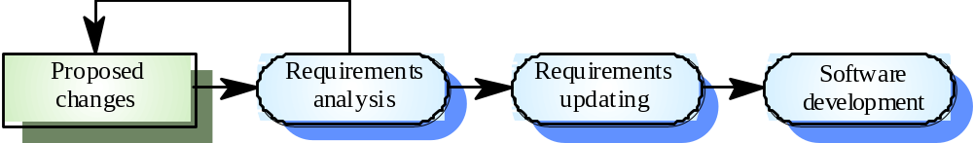
Change Implementation
Change implementation. [SOM2004]

Slide 20
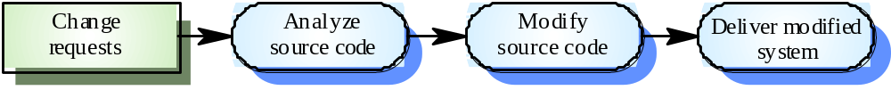
Emergency Repair
Emergency repair [SOM2004]

Slide 21
Why is Maintenance Inefficient?
Factors adversely effect maintenance
  Lack of models or ignorance of available models (73%)
  Lack of documentation (67.6%)
  Lack of time to update existing documentation (54.1%)
Other factors (1994 study)
  Quality of original application
  Documentation quality
  Rotation of maintenance people

Slide 22
Why is Maintenance Inefficient? (cont’d)
More factors (Yip ’95 study)
  Lack of human resources
  Different programming styles conflict
  Lack of documentation and tools
  Bad maintenance management
  Documentation policy
  Turnover

Slide 23
9.3 Maintenance Techniques

Slide 24
Architectural Evolution
There is a need to convert many legacy systems from a centralised architecture to a client-server architecture
Change drivers
  Hardware costs. Servers are cheaper than mainframes
  User interface expectations. Users expect graphical user interfaces
  Distributed access to systems. Users wish to access the system from different, geographically separated, computers

Slide 25
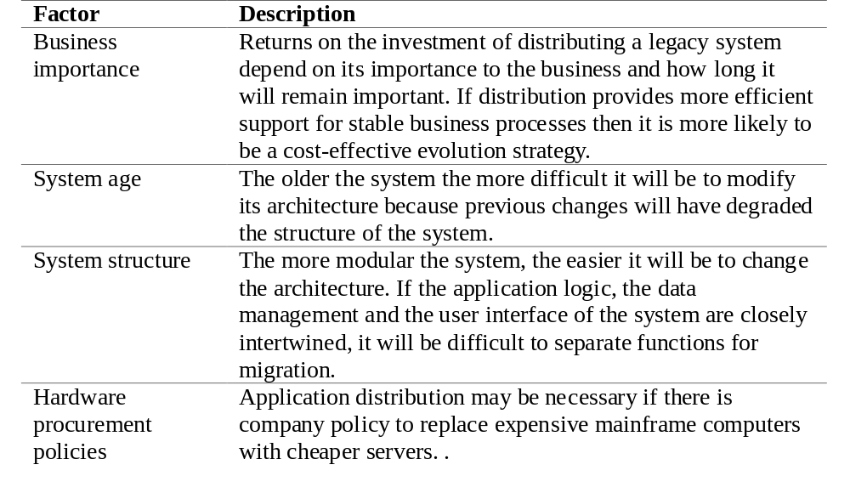
Distribution Factors [SOM2004]

Slide 26
Legacy System Structure
Ideally, for distribution, there should be a clear separation between the user interface, the system services and the system data management
In practice, these are usually intermingled in older legacy systems

Slide 27
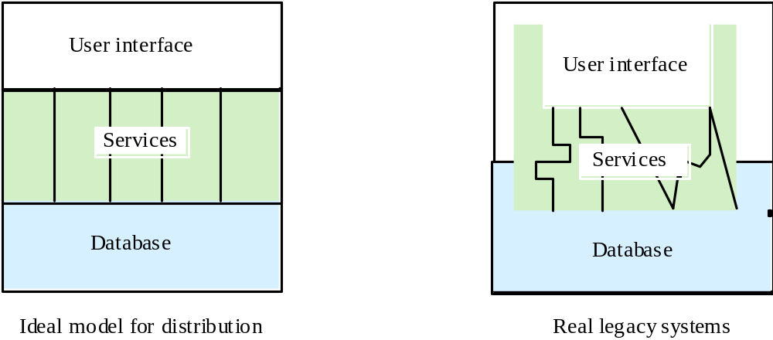
Legacy System Structures [SOM2004]

Slide 28
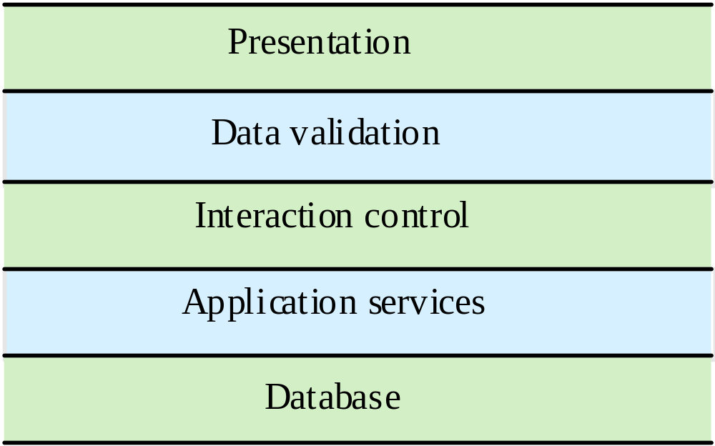
Layered Distribution Model [SOM2004]

Slide 29
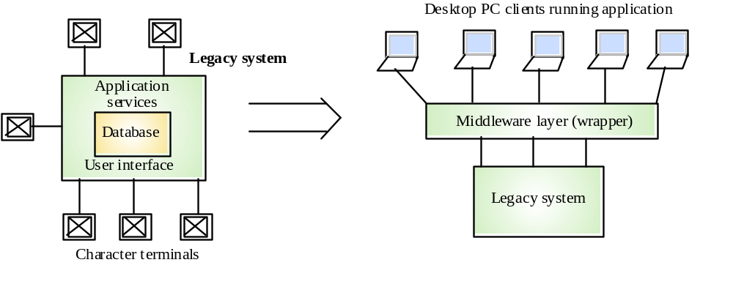
Legacy System Distribution [SOM2004]

Slide 30
Distribution Options
The more that is distributed from the server to the client, the higher the costs of architectural evolution
The simplest distribution model is UI distribution where only the user interface is implemented on the server
The most complex option is where the server simply provides data management and application services are implemented on the client

Slide 31
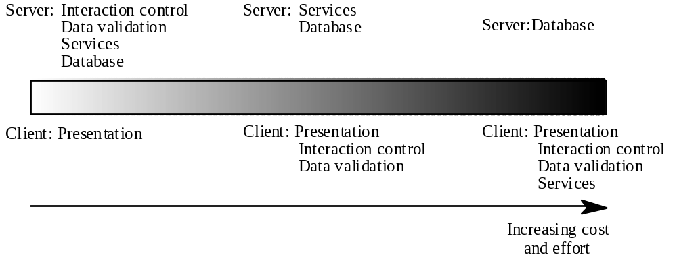
Distribution Option Spectrum [SOM2004]

Slide 32
User Interface Distribution
UI distribution takes advantage of the local processing power on PCs to implement a graphical user interface
Where there is a clear separation between the UI and the application then the legacy system can be modified to distribute the UI
Otherwise, screen management middleware can translate text interfaces to graphical interfaces

Slide 33
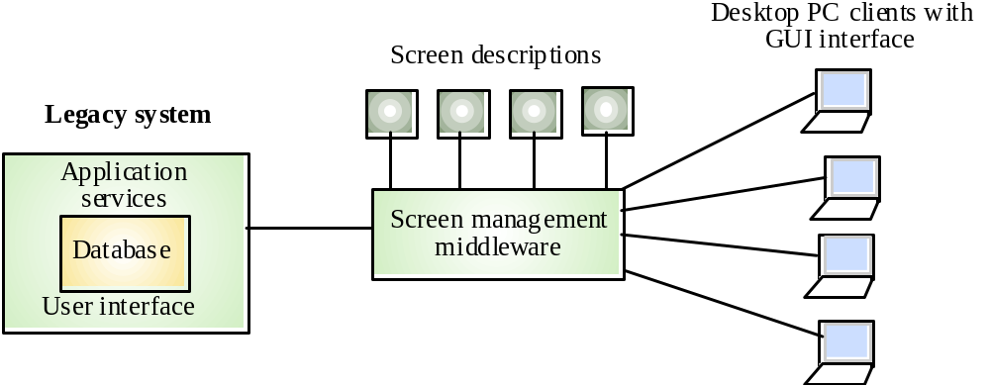
User Interface Distribution [SOM2004]

Slide 34
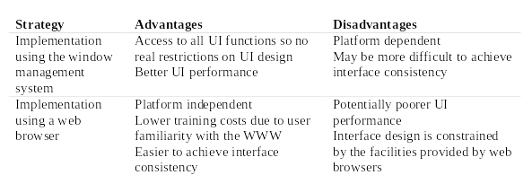
UI Migration Strategies [SOM2004]

Slide 35
9.4 The Management of Maintenance

Slide 36
Model of Maintenance Effort
Model of maintenance effort M = p + K^(c-d) [PRE2004]
M = total maintenance effort over entire lifecycle
p = productive efforts: analysis, design, code, test
c = complexity due to lack of structured design and documentation
d = degree of familiarization with the system
K = empirically determined constant

Slide 37
Model of Maintenance Effort (cont’d)
Model of maintenance effort M = p + K^(c-d)
Cost of maintenance increases exponentially.
Costs are reduced by structured development
Costs are reduced by giving the maintenance team time to become thoroughly familiar with the system

Slide 38
What Affects the Maintainability of an
Application?
Application age
  (software rust?) older programs were probably worse written and have probably been patched more
Size
  measured in KLOC, number of input/output files
Programming language
  4gls are supposed to produce more maintainable code than 3gls

Slide 39
What Affects the Maintainability of an
Application? (cont’d)
Processing environment
  files harder to maintain than databases, real-time harder than batch
Analysis and design methodologies
  well designed software is supposed to be much easier to maintain
Structured programming
  there is conflicting evidence whether this really helps

Slide 40
What Affects the Maintainability of an
Application? (cont’d)
Modularization
  (central thesis of all the oo techniques) small reasonably self contained pieces of code should be easier to maintain
Documentation generation
  maintenance of documentation is as expensive as maintenance of code
End-user involvement
  some researchers believe when end users are more involved maintenance decreases

Slide 41
What Affects the Maintainability of an
Application? (cont’d)
Maintenance management
  scheduling and the attitudes of management to affects productivity

Slide 42
Problems in Managing Maintenance
Changing priorities
  chaotic nature of maintenance requests, the length of maintenance tasks causing new requests to come along before an ongoing task is done.
Inadequate testing methods
  lack of time set aside for testing, of comprehensive test data, of rigorous testing requirements as a standard for signing off.
Performance measurement difficulties
  how do you measure individual or group performance?
System documentation incomplete or non-existent
  training takes a long time for learning an application so programmers get stuck on one piece of software.
Adapting to the rapidly changing business environment
  hardware and software also become obsolete.

Slide 43
Problems in Managing Maintenance (cont’d)
From survey of 60 US & Canadian companies in Software Maintenance News 1992
  These are the consequence of the lack of mature tools and techniques for software maintenance and its management.
  We need predictive models of maintenance to estimate how much effort needs to go into it.
  By and large maintainers work in isolation and are not closely managed. Each one has to learn from personal experience good methods of working.

Slide 44
Maintenance Prediction
Maintenance prediction is concerned with assessing which parts of the system may cause problems and have high maintenance costs
  Change acceptance depends on the maintainability of the components affected by the change
  Implementing changes degrades the system and reduces its maintainability
  Maintenance costs depend on the number of changes and costs of change depend on maintainability

Slide 45
Maintenance Prediction (cont’d)
Predicting the number of changes requires and understanding of the relationships between a system and its environment
Tightly coupled systems require changes whenever the environment is changed
Factors influencing this relationship are
  Number and complexity of system interfaces
  Number of inherently volatile system requirements
  The business processes where the system is used

Slide 46
Maintenance Prediction (cont’d)
Predictions of maintainability can be made by assessing the complexity of system components
Studies have shown that most maintenance effort is spent on a relatively small number of system components
Complexity depends on
  Complexity of control structures
  Complexity of data structures
  Procedure and module size

Slide 47
Maintenance Prediction (cont’d)
Process measurements may be used to assess maintainability
  Number of requests for corrective maintenance
  Average time required for impact analysis
  Average time taken to implement a change request
  Number of outstanding change requests
If any or all of these is increasing, this may indicate a decline in maintainability

Slide 48
Maintenance Costs
Usually greater than development costs (2* to
100* depending on the application)
Affected by both technical and non-technical
factors
Increases as software is maintained.
Maintenance corrupts the software structure so
makes further maintenance more difficult.
Ageing software can have high support costs
(e.g. old languages, compilers etc.)

Slide 49
Maintenance Costs (cont’d)
Time and money (software that costs £ 10 a line to develop costs £ 400 a line to maintain)
Organizations become maintenance bound and cannot produce new software
Customer dissatisfaction when seemingly legitimate requests for repair or modification cannot be addressed in a timely manner
Reduction in overall software quality as changes introduce latent errors in the maintained software
Upheaval caused during development efforts when staff must be “pulled” to work on a maintenance task

Slide 50
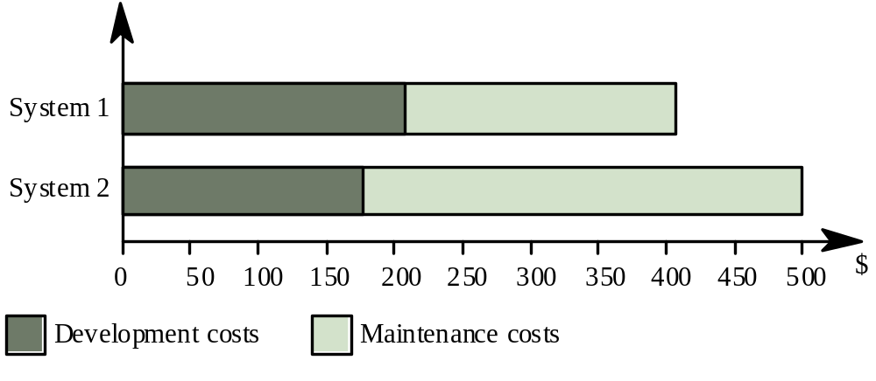
Development/Maintenance Costs [SOM2004]

Slide 51
Maintenance Cost Factors
Team stability
  Maintenance costs are reduced if the same staff are involved with them for some time
Contractual responsibility
  The developers of a system may have no contractual responsibility for maintenance so there is no incentive to design for future change
Staff skills
  Maintenance staff are often inexperienced and have limited domain knowledge
Program age and structure
  As programs age, their structure is degraded and they become harder to understand and change

Slide 52
Change Management
Change is a fact of life for large software. A defined change management process and associated CASE tools ensure that these changes are recorded and applied to the system in a cost-effective way.
The change management process should come into effect when the software associated document is put under the control of the configuration management team.
Change management procedures should be designed to ensure that the costs and benefits of change are properly analyzed and changes to a system are made in a controlled way.

Slide 53
Change Management Process
Request change by completing a change request form
Analyze change request
If change is valid then {
  Assess how change might be implemented
  Assess change cost
  Record change request in database
  Submit request to change control board

Slide 54
Change Management Process (cont’d)
    If change is accepted then{
    Repeat{
      make changes to software
      record changes and link to associated change request
      submit changed software for quality approval}
    Until{
      software quality is adequate
      create new system version}}
  else
    {reject change request}}

Slide 55
Change Request Form [SOM2004]
Project: Proteus/PCL-Tools Number: 23/94
Change requester: I.Sommerville Date: 1/9/98
Requested change: when a component is selected from the structure, display the name of the file where it is stored.
Change analyzer: G.Dean analysis Date:10/9/98
Components affected: Display-icon.Select, Display-icon.Display
Associated component: File Table
Change assessment: Relatively simple to implement as a file name table is available. Requires the design and implementation of a display field. No changes to associated components are required.
Change priority: Low
Change implementation:
Estimated effort: 0.5 days
Date to CCB: 15/9/98 CCB decision date: 1/11/98
Change implementor: Date of change:
Date submitted to QA: QA decision:
Date submitted to CM:
comments
CCB- change control board

Slide 56
9.5 Qualities in Maintenance

Slide 57
Maintenance Side Effects
In this context a side effect implies an error or undesirable behavior that occurs as the result of a modification.
the three major areas are[PRE2004]
  code
  data structures
  documentation

Slide 58
Documentation Side Effects
These consist of the failure to update documentation so that it no longer matches the code.
If the user doesn’t know about changes frustration is inevitable.
The entire documentation should be reviewed before re-release

Slide 59
Coding Side Effects
Any change can cause side-effects but these tend to be more error prone a subprogram is deleted or changed
A statement label is deleted or modified
An identifier is deleted or modified
Changes are made to improve execution performance

Slide 60
Coding Side Effects (cont’d)
Logical operators are modified
Files are opened or closed
Design changes which translate into major code changes
Changes are made to logical tests of boundary conditions
These may be caught in testing or cause software failure during operation.

Slide 61
Data Side Effects
Data side effects occur as the result of modifications made to a data structure. The most error-prone are:
  redefinition of local and global constants
  redefinition of record or file formats
  Incr. or decr. in size of array or other data structure
  modification of global data
  re initialization of control flags and pointers
  rearrangements of parameters (especially in I/O)

Slide 62
9.6 Re-engineering, Reverse Engineering and Forward Engineering,

Slide 63
Software Rejuvenation
Re-documentation
  Creation or revision of alternative representations of software
    at the same level of abstraction
  Generates:
    data interface tables, call graphs, component/variable cross references etc.
Restructuring
  transformation of the system’s code without changing its behavior

Slide 64
Software Rejuvenation (cont’d)
Reverse Engineering
  Analyzing a system to extract information about the behavior and/or structure
    also Design Recovery - recreation of design abstractions from code, documentation, and domain knowledge
  Generates:
    structure charts, entity relationship diagrams, DFDs, requirements models
Re-engineering
  Examination and alteration of a system to reconstitute it in another form
  Also known as renovation, reclamation

Slide 65
System Re-engineering
Re-structuring or re-writing part or all of a
legacy system without changing its
functionality
Applicable where some but not all sub-systems
of a larger system require frequent
maintenance
Re-engineering involves adding effort to make
them easier to maintain. The system may be re-structured and re-documented

Slide 66
When to Re-engineer
When system changes are mostly confined to
part of the system then re-engineer that part
When hardware or software support becomes
obsolete
When tools to support re-structuring are
available

Slide 67
Re-engineering Advantages
Reduced risk
  There is a high risk in new software development. There may be development problems, staffing problems and specification problems
Reduced cost
  The cost of re-engineering is often significantly less than the costs of developing new software

Slide 68
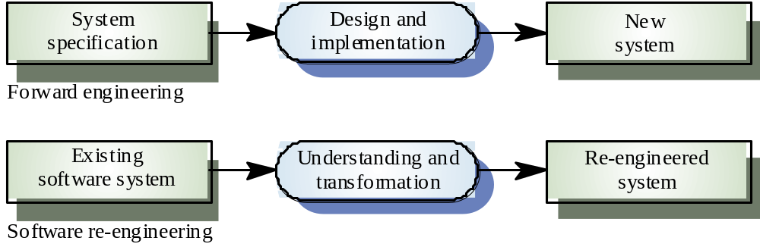
Forward Engineering and Re-engineering [SOM2004]

Slide 69
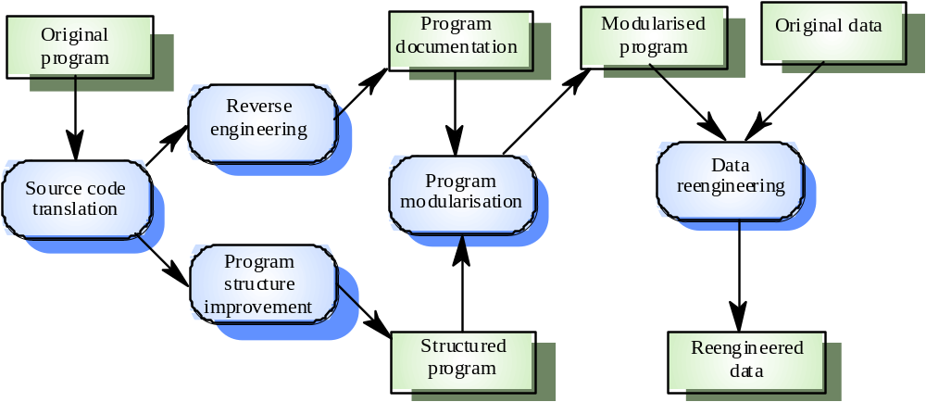
The Re-engineering Process [SOM2004]

Slide 70
Re-Engineering Cost Factors
The quality of the software to be re-engineered
The tool support available for re-engineering
The extent of the data conversion which is required
The availability of expert staff for re-engineering

Slide 71
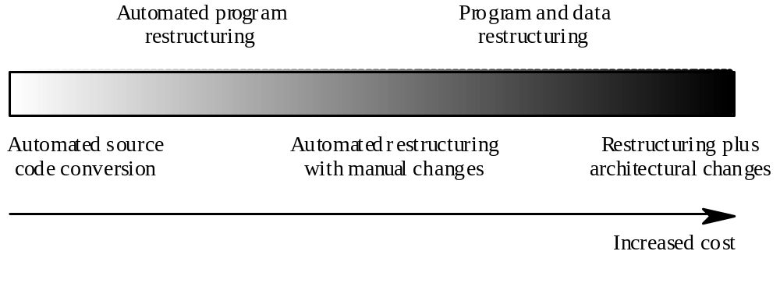
Re-Engineering Approaches [SOM2004]

Slide 72
Source Code Translation
Involves converting the code from one language (or language version) to another e.g. FORTRAN to C
May be necessary because of:
  Hardware platform update
  Staff skill shortages
  Organisational policy changes
Only realistic if an automatic translator is available

Slide 73
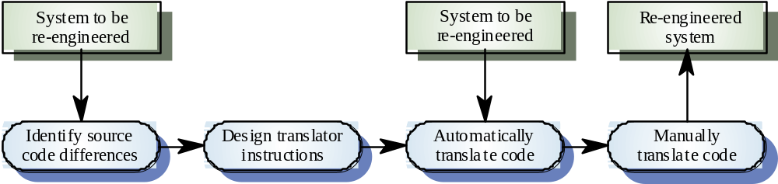
The Program Translation Process [SOM2004]

Slide 74
Program Structure Improvement
Maintenance tends to corrupt the structure of a program. It becomes harder and harder to understand
The program may be automatically restructured to remove unconditional branches
Conditions may be simplified to make them more readable

Slide 75
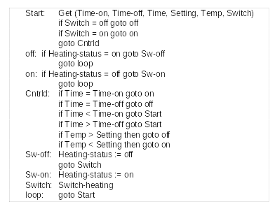
Spaghetti Logic [SOM2004]

Slide 76
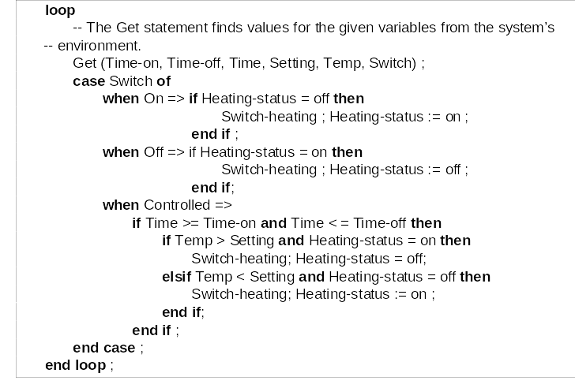
Structured Control Logic [SOM2004]

Slide 77
Condition Simplification
-- Complex condition
if not (A > B and (C < D or not ( E > F) ) )...
-- Simplified condition
if (A <= B and (C>= D or E > F)...

Slide 78
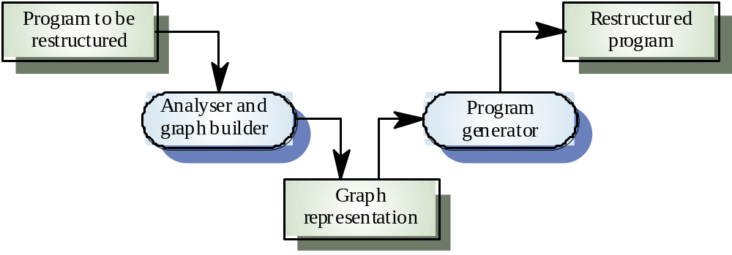
Automatic Program Restructuring [SOM2004]

Slide 79
Restructuring Problems
Problems with re-structuring are:
  Loss of comments
  Loss of documentation
  Heavy computational demands
Restructuring doesn’t help with poor modularisation where related components are dispersed throughout the code
The understandability of data-driven programs may not be improved by re-structuring

Slide 80
Module types
Data abstractions
  Abstract data types where data structures and associated operations are grouped
Hardware modules
  All functions required to interface with a hardware unit
Functional modules
  Modules containing functions that carry out closely related tasks
Process support modules
  Modules where the functions support a business process or process fragment

Slide 81
Recovering Data Abstractions
Many legacy systems use shared tables and global data to save memory space
Causes problems because changes have a wide impact in the system
Shared global data may be converted to objects or ADTs
  Analyse common data areas to identify logical abstractions
  Create an ADT or object for these abstractions
  Use a browser to find all data references and replace with reference to the data abstraction

Slide 82
Data Abstraction Recovery
Analyse common data areas to identify logical abstractions
Create an abstract data type or object class for each of these abstractions
Provide functions to access and update each field of the data abstraction
Use a program browser to find calls to these data abstractions and replace these with the new defined functions

Slide 83
Data Re-engineering
Involves analysing and reorganising the data structures (and sometimes the data values) in a program
May be part of the process of migrating from a file-based system to a DBMS-based system or changing from one DBMS to another
Objective is to create a managed data environment

Slide 84
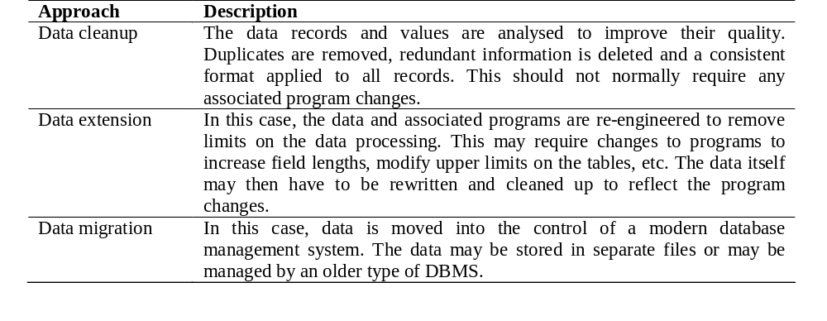
Approaches to Data Re-engineering [SOM2004]

Slide 85
Data Problems
End-users want data on their desktop machines rather than in a file system. They need to be able to download this data from a DBMS
Systems may have to process much more data than was originally intended by their designers
Redundant data may be stored in different formats in different places in the system

Slide 86
Data Problems (cont’d)
Data naming problems
  Names may be hard to understand. The same data may have different names in different programs
Field length problems
  The same item may be assigned different lengths in different programs
Record organisation problems
  Records representing the same entity may be organised differently in different programs
Hard-coded literals
No data dictionary

Slide 87
Data Conversion
Data re-engineering may involve changing the data structure organisation without changing the data values
Data value conversion is very expensive. Special-purpose programs have to be written to carry out the conversion

Slide 88
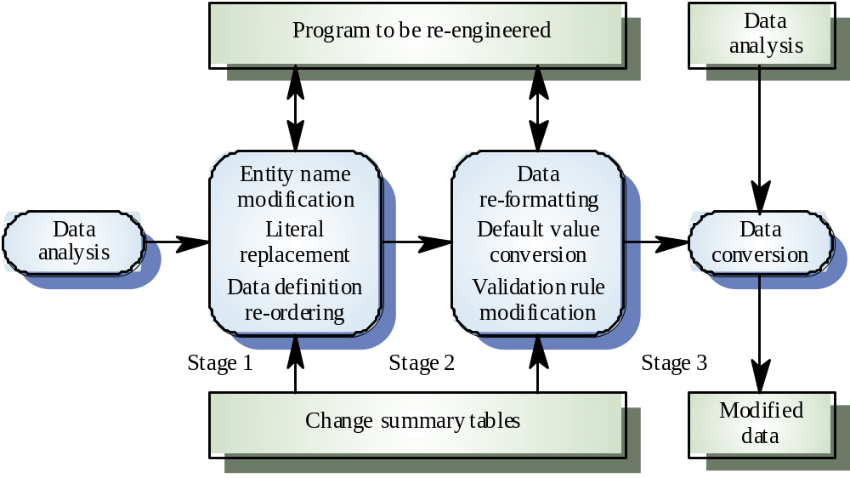
The Data Re-engineering Process [SOM2004]

Slide 89
Reverse Engineering
Analysing software with a view to understanding its design and specification
May be part of a re-engineering process but may also be used to re-specify a system for re-implementation
Builds a program data base and generates information from this
Program understanding tools (browsers, cross-reference generators, etc.) may be used in this process

Slide 90
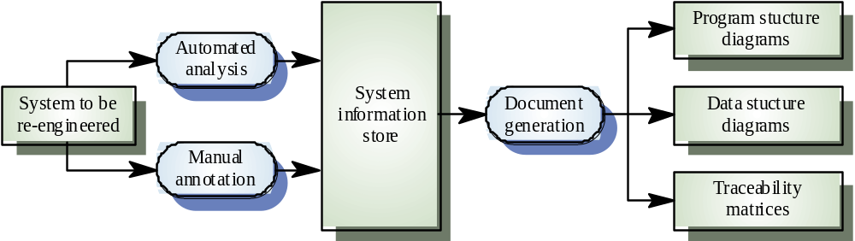
The Reverse Engineering Process [SOM2004]

Slide 91
References
[PRE2004] Roger S. Pressman. Software Engineering: a practitioner’s approach, 6th edition. McGRAW-HILL, 2004.
[SOM2004] Ian Sommerville. Software Engineering, 7th edition. Addison Wesley, 2004

